Slide 1
Capstone Project 2 Supervised ML – regression Bike Sharing Demand Prediction
Submitted -By
Vibha Kumari

Slide 2
Problem statement:
Currently Rental bikes are introduced in many urban cities for the enhancement of mobility comfort. It is important to make the rental bike available and accessible to the public at the right time as it lessens the waiting time.
Eventually, providing the city with a stable supply of rental bikes becomes a major concern.
This prior knowledge of knowing the bike demand at the right time is crucial for bike rental companies in the city of Seoul.
Our main aim here is to solve this problem and predict the bike demand across different hours and also various other inputs which are related to the weather conditions of the city.

Slide 3
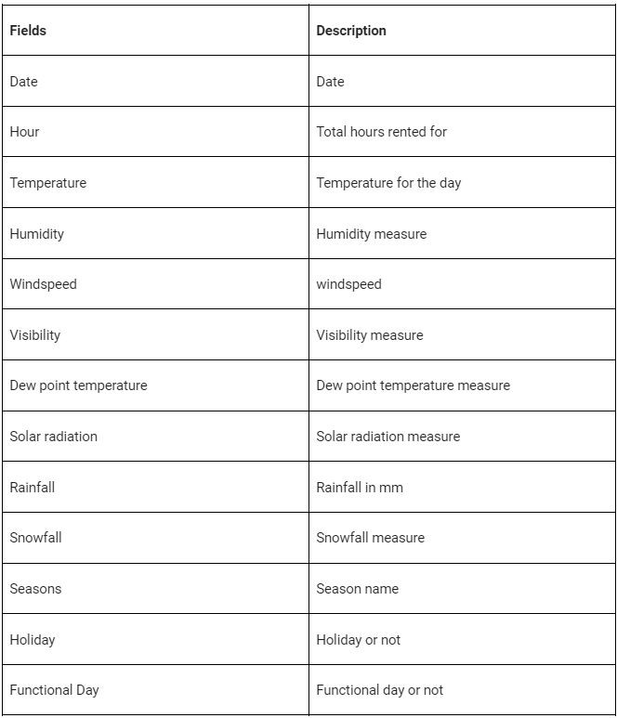
DATASET

Slide 4
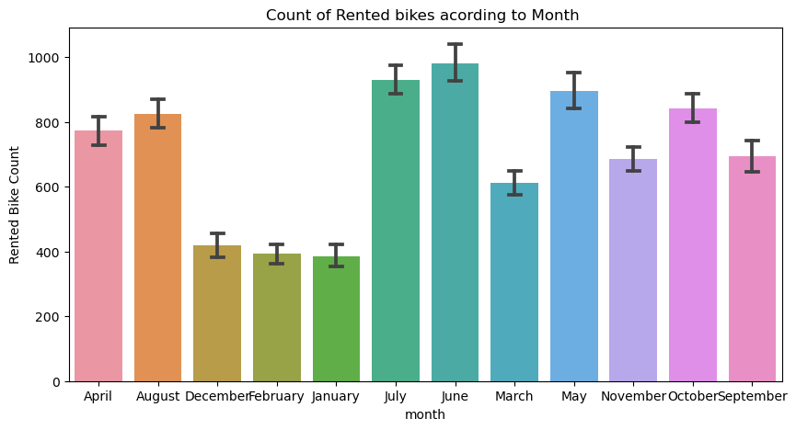
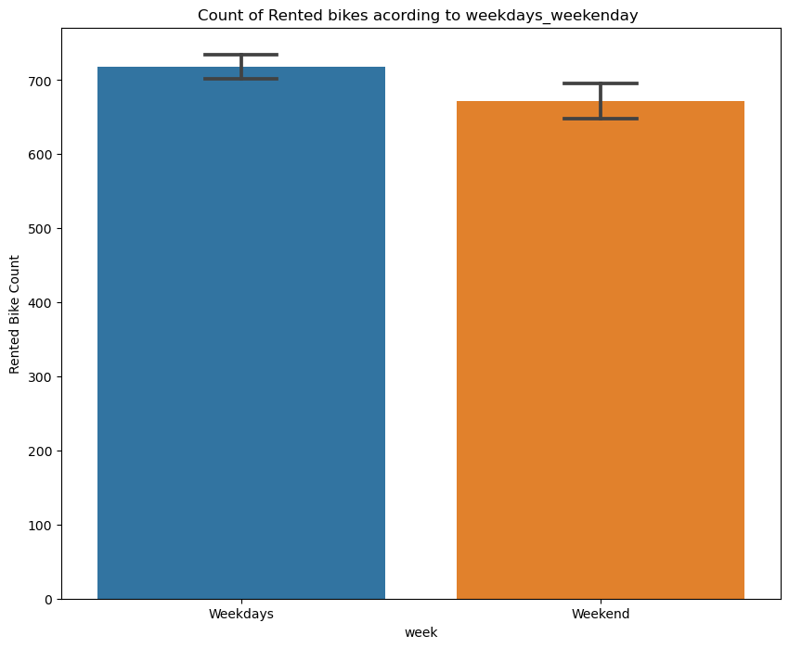
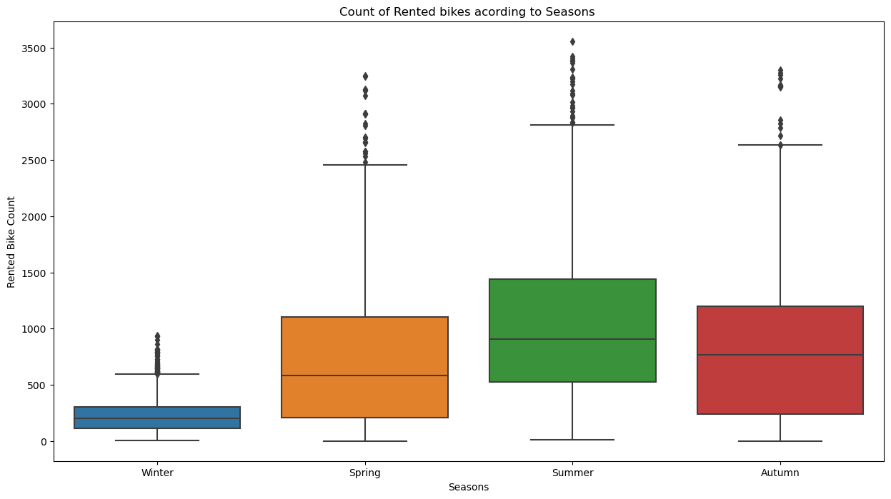
EDA
From the above bar plot we can clearly say that from the month 5 to 10 the demand of the rented bike is high as compare to other months.
In weekdays count of rented bike are more in comparison to weekend.
it clearly shows that, In summer season the use of rented bike is high In winter season the use of rented bike is very low because of snowfall.

Slide 5
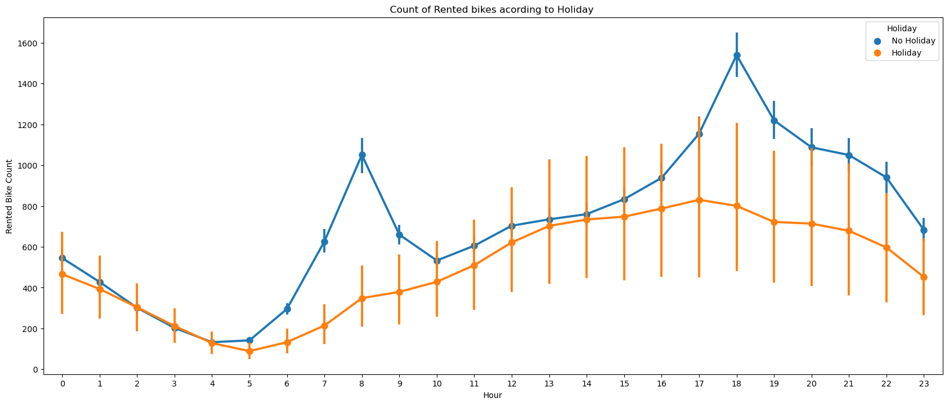
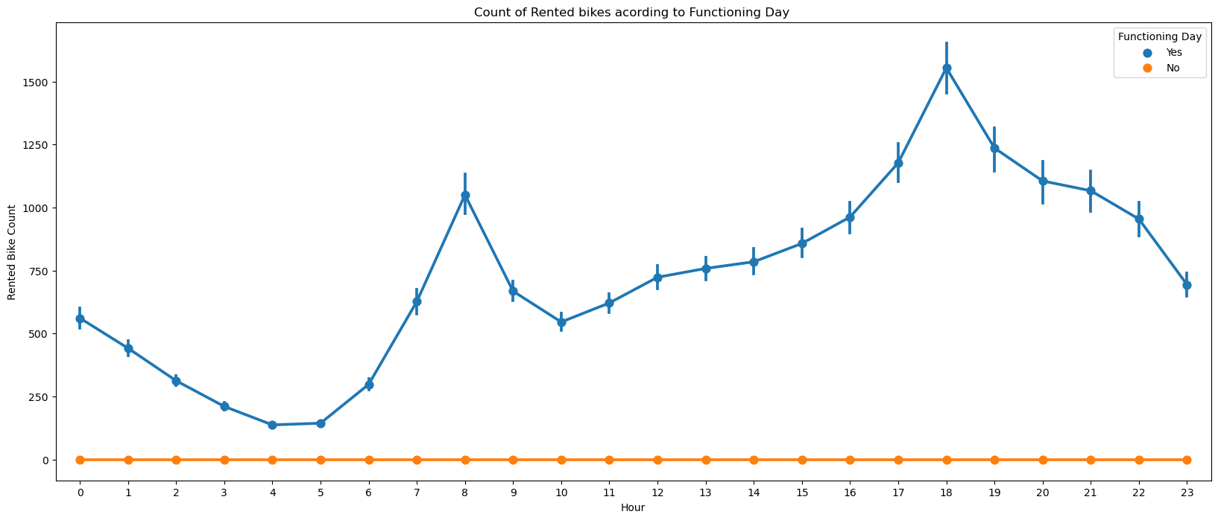
the demand of the bike higher because of the office. Peak Time are 7 am to 9 am and 5 pm to 7 pm The orange color represent the weekend days, and it show that the demand of rented bikes are very low specially in the morning hour but when the evening start from 4 pm to 8 pm the demand slightly increases
clearly shows that, Peoples don't use rented bikes in no functioning day .

Slide 6
Cleaning Data:
Handling Null values: In this project the first step in Data cleaning is Handling the null values. Null values can affect the accuracy and quality of our ML models, therefore it is a good practice to handle null values. In our case, fortunately there are no null values in our dataset, so we are good to go.
Handling duplicate values: Duplicate values can have adverse effects on our ML models, therefore we have to try and remove it. Luckily we don’t have any duplicate values either so we can move on to the next step in data cleaning.
Removing Outliers: First of all we find the variables that may contain outliers, to detect this I’ve used the box plot offered by seaborn library. try to remove the outliers from them using the IQR method.

Slide 7
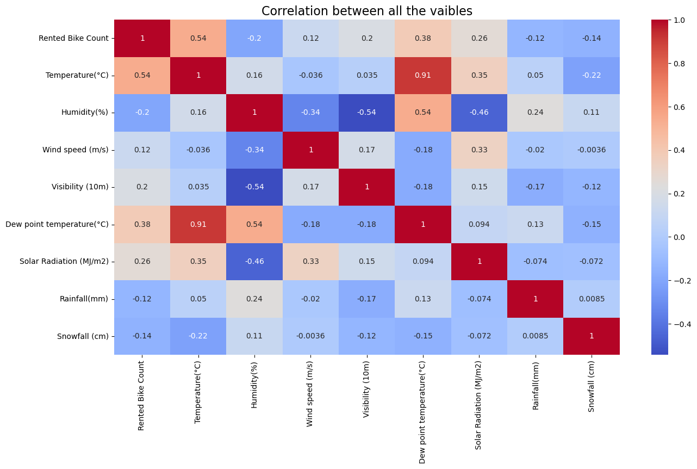
Feature Engineering:
:
Checking correlation for feature removal
Here we can see that the column Dew point
temperature has high correlation with the
Temperature column.
I also don’t think that the dew point
temperature would add any value to the ML model,
therefore keeping these things in mind,
I’ve dropped the Dew point temperature column.

Slide 8
LINEAR REGRESSION
MSE : 63.9737098153107
RMSE : 7.998356694678645
MAE : 6.097329463925885
R2 : 0.584561154517067
Adjusted R2 : 0.5793729728204717
In regression MAE ,MSE ,RMSE ,R-squared and Adjusted R-squared are mainly used metrics to evaluate performance of this model.
Lower the value of MSE,RMSE ,MAE , better the model predict.
Higher the R –squared value ,better the model fits.

Slide 9
linear regression with L2 regularization
MSE : 63.970414183155796
RMSE : 7.99815067269652
R2 : 0.5950378509066457
Adjusted R2 : 0.5899805067690322
In regression MAE ,MSE ,RMSE ,R-squared and Adjusted R-squared are mainly used metrics to evaluate performance of this model.
Lower the value of MSE,RMSE ,MAE , better the model predict.
Higher the R –squared value ,better the model fits.

Slide 10
linear regression with elastic net
MSE : 64.21904581736311
RMSE : 8.013678669460306
MAE : 6.120582120893882
R2 : 0.582967967163351
Adjusted R2 : 0.5777598890474447
In regression MAE ,MSE ,RMSE ,R-squared and Adjusted R-squared are mainly used metrics to evaluate performance of this model.
Lower the value of MSE,RMSE ,MAE , better the model predict.
Higher the R –squared value ,better the model fits.

Slide 11
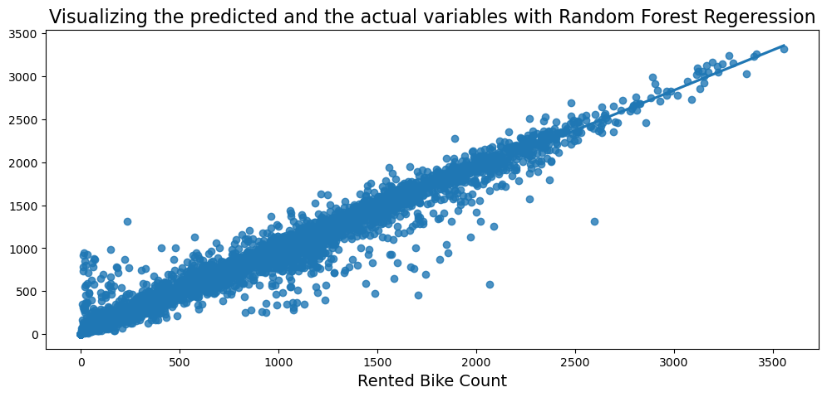
Random Forest Regressor with Grid SearchCV
MSE= 6.256727094752333
RMSE= 2.501345057114738
R2_Score_train= 0.9593694427249925
MSE= 24.438900966231504
RMSE= 4.943571681105828
R2_Score_test= 0.8452905146365189

Slide 12
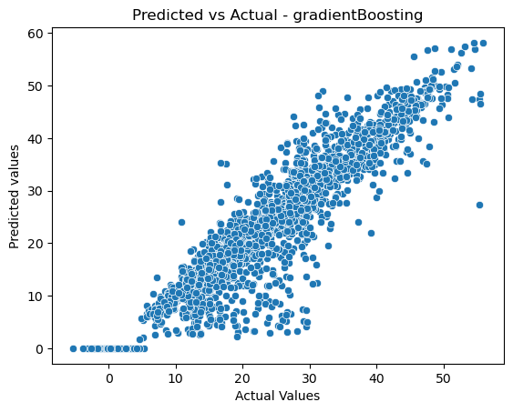
Gradient Boosting Regressor with Grid SearchCV

Slide 13
comparing the model with r2 value
 | linear_ regression | Ridge_model | elasticnet | random forest | gradient
r2_value | 0.584561 | 0.595038 | 0.57776 | 0.845291 | 0.854841
R-square is also known as coefficient of determination , it’s the proportion of variation in y explained by independent variable x.
It’s a measures of goodness of fit of model . R2 score of 0.85 means 85% variation in the output can be explained by input variable.

Slide 14
conclusion
● Hour of the day holds most importance among all the features for prediction of
dataset
● It is observed that highest number bike rentals counts in Summer
Seasons and the lowest in Winter season.
● We observed that the highest number of bike rentals on a clear day and the lowest on
a snowy or rainy day
● Peoples dont use rented bikes in no functioning day
● for all the above experiments we can conclude that by gradient boosting we got the best result.

Slide 15
e
Thank you

